Slide 1
How to Present Data
YUBA Workshop
Jeff Quinn

Slide 2
What does “Data Analysis” Mean To You?

Slide 3
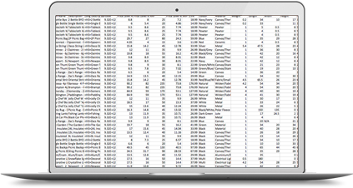

Notes:
A data analyst’s job is to take a bunch of ugly, incomprehensible data and extract meaningful information from it. Data analysis sounds boring, but to me it can be a very artistic thing. Creating something that is both visually appealing, and elegantly simplifies a complex subject.

Slide 4
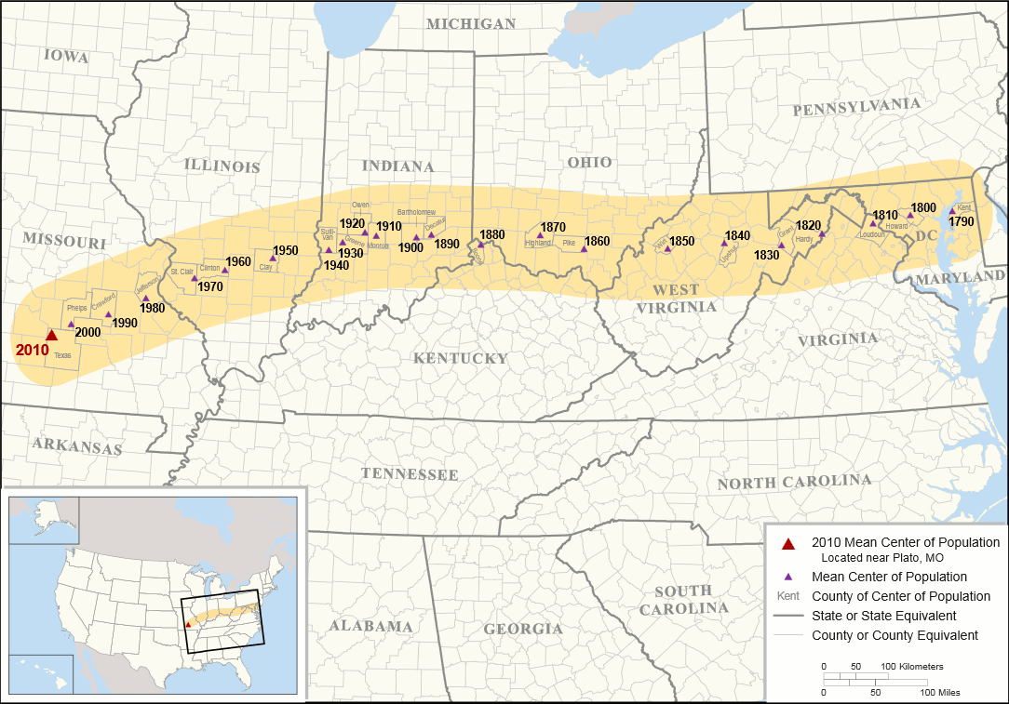
Notes:
Mean center of population in the US
Data: US population by geographical area
Message: Between 1790 and present day, the US population has moved westward more and more.

Slide 5
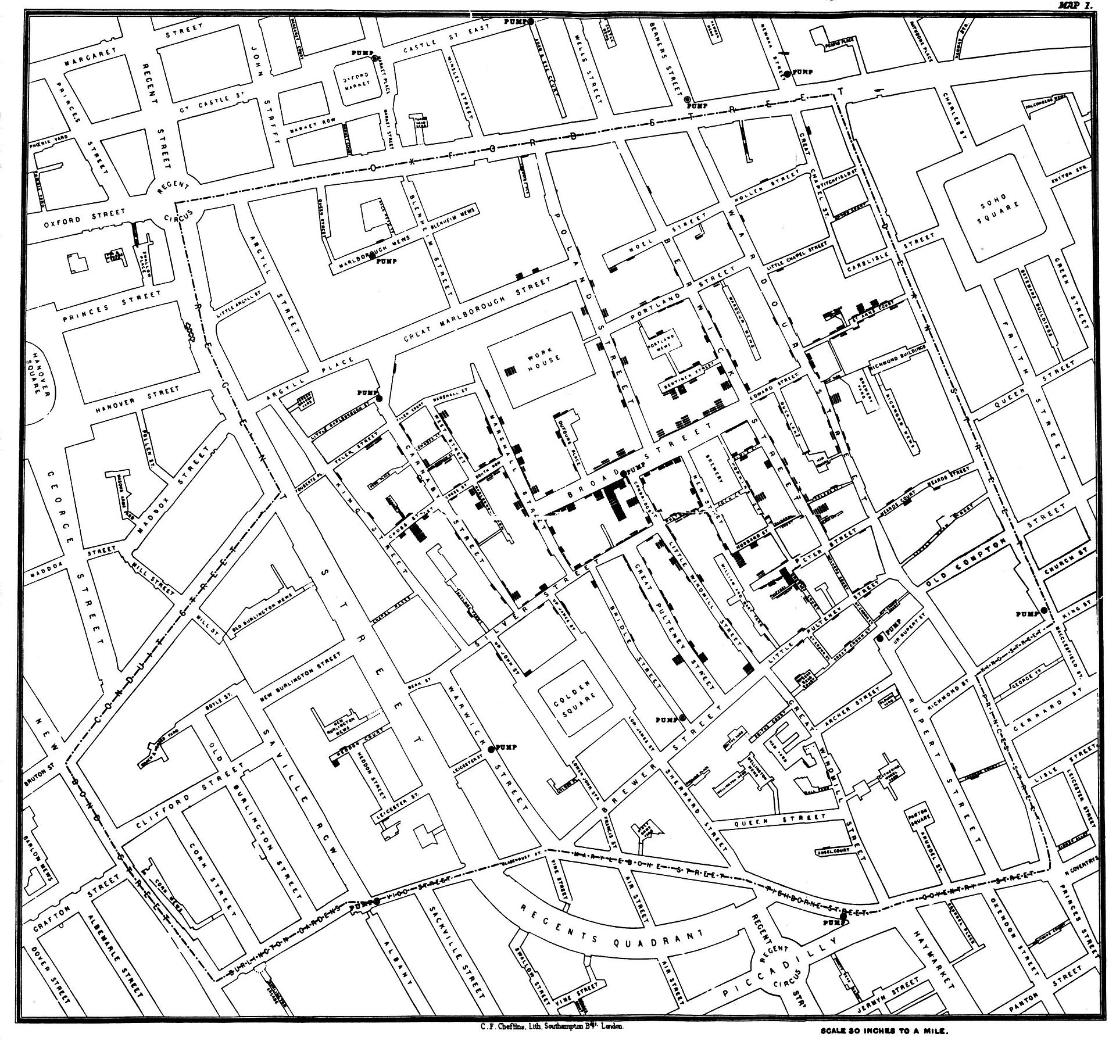
Notes:
John Snow’s Cholea map
Data: Incidences of cholera by address in london.
Message: A water pump on broad street is the source of the outbreak.

Slide 6
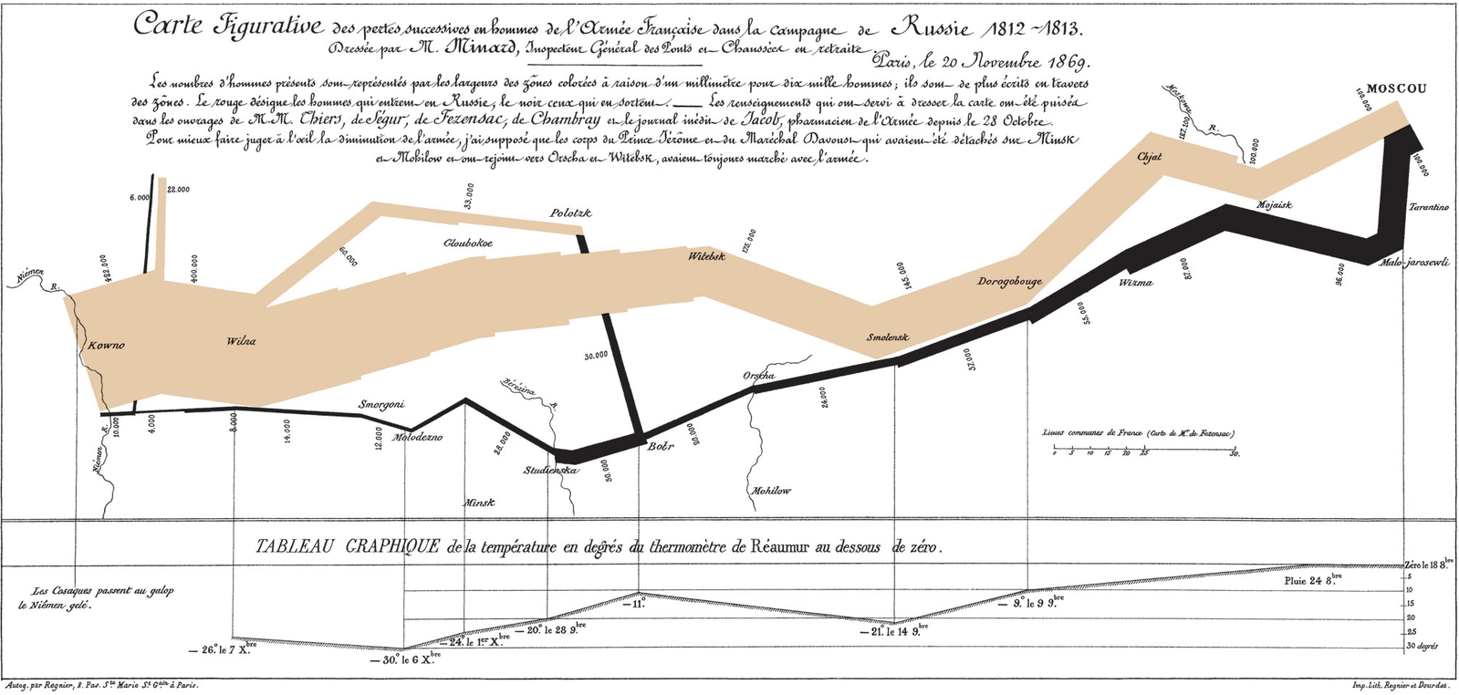
Notes:
Minard’s visualization of Napoleon’s russian campaign in the war of 1812. Napoleon marched his troops east and russian troops just kept retreating all the way to moscow, burning all the crops and shelter before they left. Eventually due to a lack of rations and exaustion, napoleon had to retreat his troops back to france, but seeing as it was nearly winter, he lost almost his entire army to cold and starvation during the journey home.
Data: Number and location of napoleon’s troops, as well as the temperature.
Message: Napoleon made a huge mistake.

Slide 7
Presentation Tools

Slide 8
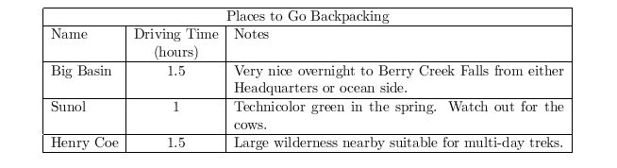
The Table
Only for a very small number of columns and rows.
Only if data values are immediately interpretable.

Slide 9
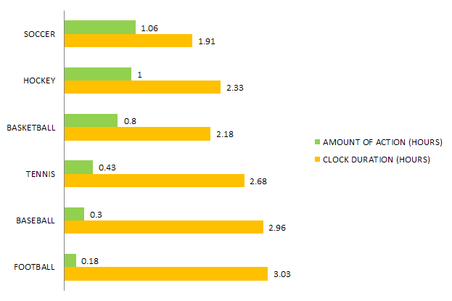
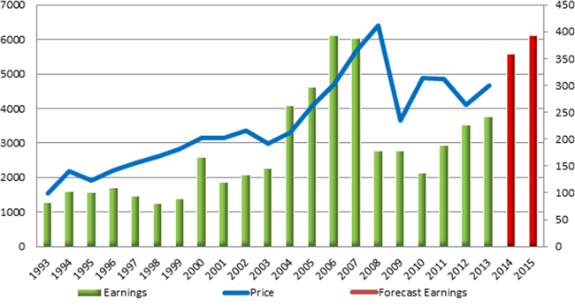
The Bar Chart
Only for a small number of categories
X-axis should have meaningful ordering
Notes:
Either order by max to min, or by increasing time, etc.

Slide 10
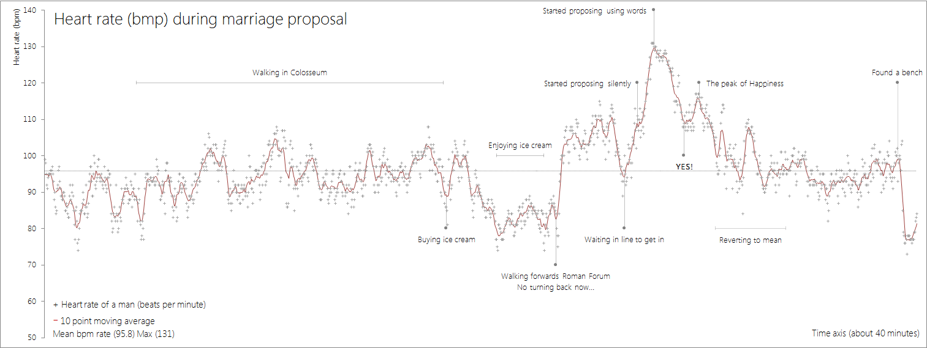
The Line Chart
More suitable for continuous data
Notes:
“Continuous” means data that can change bit by bit, ie time, weight, length, etc

Slide 11
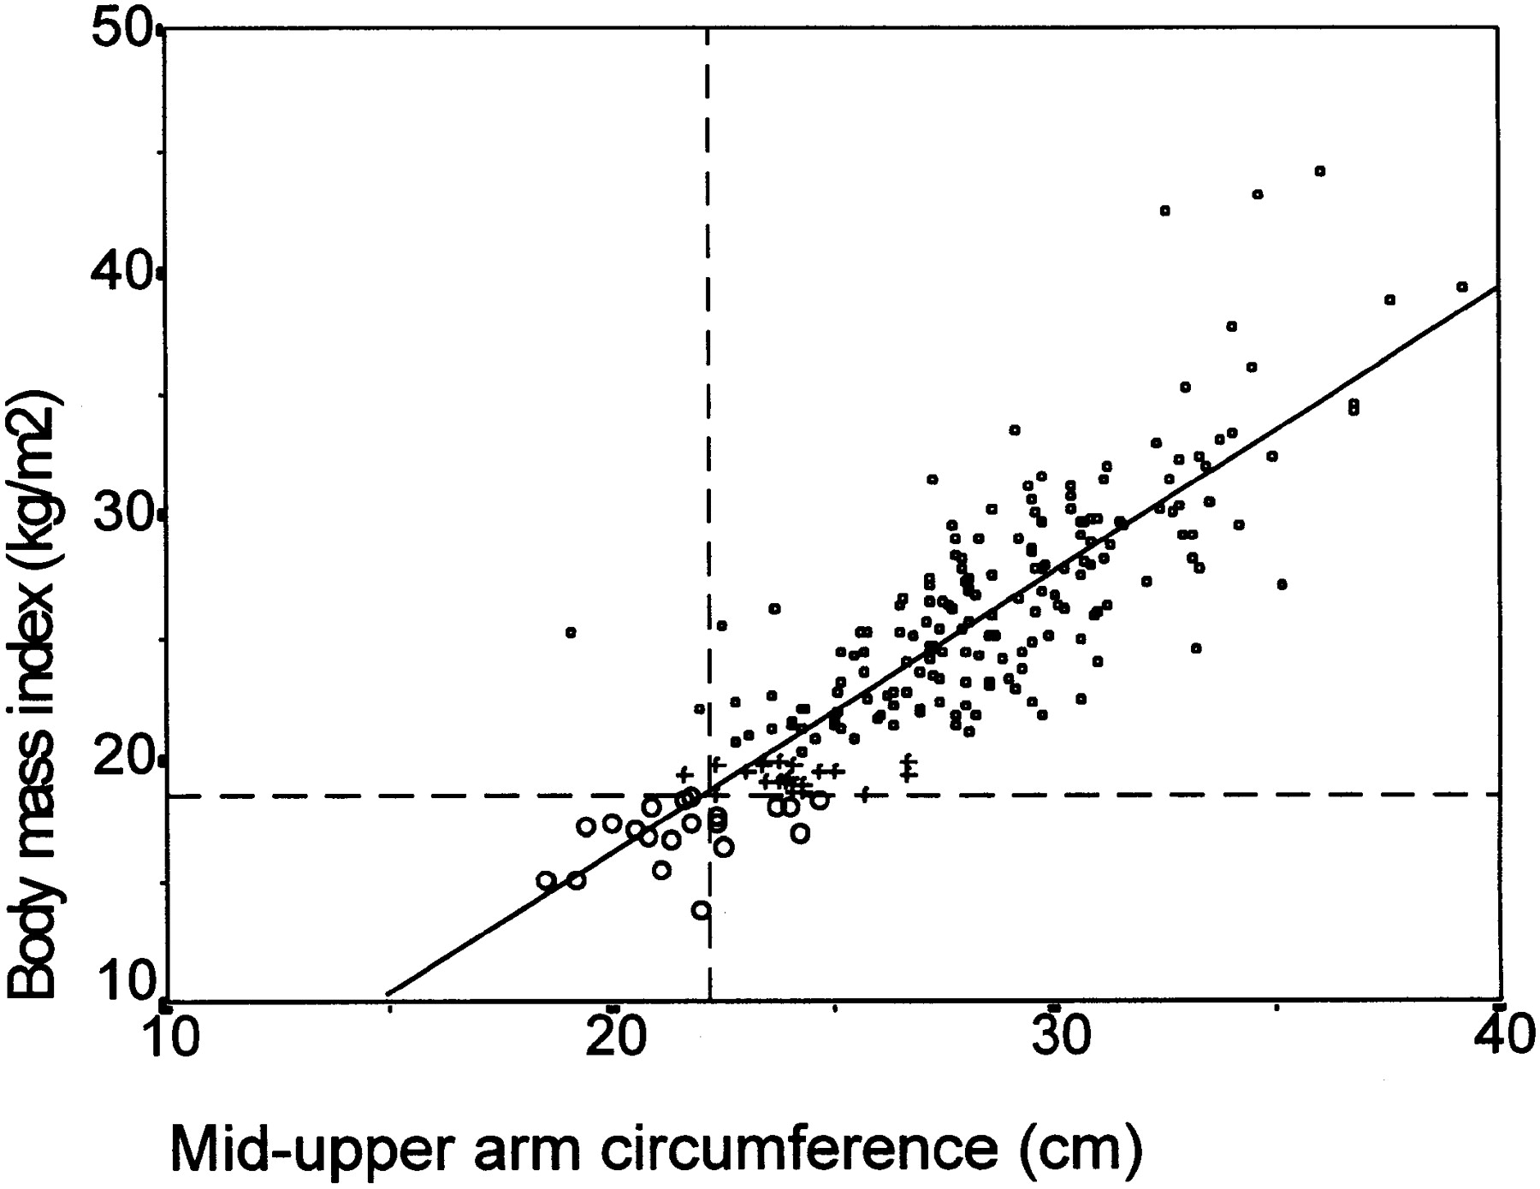
The Scatterplot
Shows relationship between two variables
Continuous or discrete/ordinal variables
Notes:
Optionally you can add a “trendline” which highlights the relationship. This trendline is from a linear regression.

Slide 12
Presentation Advice

Slide 13
Know Your Audience
Who is going to be in the room?
Will they care more about the “how”, the “why”, or the “so what?”
Notes:
If you make 10 slides going on about what your results mean for the company, but your presentation is to other data analysts, you might never get to that stuff, as they will ask mostly questions about how you carried out your analysis and whether it is correct or not. If you are presenting to the CEO, but all your slides are about how you collected and analyzed your data, they are going to be completely tuned out.

Slide 14
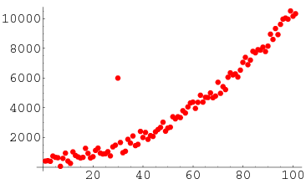
Anticipate Questions
What do you think the first question would be if you presented this scatterplot in a meeting?
Notes:
This is known as an “outlier”.
Make sure to allocate PLENTY of time to questions whenever you show a figure or visualization that you’ve made, unless it is really simple or they have seen it before.

Slide 15
Don’t Lead With the Details
Your job is to simplify the data, protect your audience from the complicated stuff and only tell them what really matters
No matter who your audience is you will always need to spare them some level of detail to get through a presentation

Slide 16
But, Always Be Ready to go into the Details
In the course of Q&A, people might end up asking really detailed questions about your data set
Always be honest if you don’t know some detail about your data
Notes:
You’ll confuse people if you try to act like you know why something is when you don’t, or you might insult their intelligence.

Slide 17
Dataset for Today’s Workshop

Slide 18

Integrated Postsecondary Education Data System
System of surveys conducted annually and made public by the U.S. Department’s National Center for Education Statistics (NCES).
Collect info on enrollment demographics, tuition, financial aid, graduation rates, and institutional resources.
Has info on every college, university, and technical and vocational institution that participates in the federal financial aid programs.

Slide 19
<bitly link to dataset>

